Slide 1
Intro to RISC-V (California Gold)

Slide 2
Floating Point Discussion
Floating Point Discussion
The RISC-V Instruction Set Architecture
Elements of Architecture: Registers
Add/Sub Instructions
Immediates

Slide 3
Floating Point Fallacy
FP add associative?
x + (y + z) = –1.5x10³⁸ + (1.5x10³⁸ + 1.0) = –1.5x10³⁸ + (1.5x10³⁸) = 0.0
(x + y) + z = (–1.5x10³⁸ + 1.5x10³⁸) + 1.0 = (0.0) + 1.0 = 1.0
Therefore, Floating Point add is not associative!
Why? FP result approximates real result!
With bigger exponents, step size between floats gets bigger, too!
This example: 1.5 x 10³⁸ is so much larger than 1.0 that 1.5 x 10³⁸ + 1.0 in floating point representation rounds to 1.5 x 10³⁸.
x
– 1.5 x 10³⁸
y
1.5 x 10³⁸
z
1.0

Slide 4
Rounding
Under the hood
When we perform math on real numbers, we have to worry about rounding to fit the result in the significand field.
The FP hardware carries two extra bits of precision, and then rounds to get the proper value
Rounding also occurs when converting:
double to a single precision value, or
floating point number to an integer

Slide 5
IEEE FP’s Four Rounding Modes
Under the hood
Round towards +∞
ALWAYS round “up”: 2.001 → 3, -2.001 → -2
Round towards –∞
ALWAYS round “down”: 1.999 → 1, -1.999 → -2
Truncate
Just drop the last bits (round towards 0)
(default) Unbiased. If midway, round to even
Normal rounding, almost: 2.4 → 2, 2.6 → 3, 2.5 → 2, 3.5 → 4
Round like you learned in grade school (nearest representable number)…
…except if the value is right on the borderline, in which case we round to the nearest EVEN number
Ensures fairness on calculation, balances out inaccuracies.
On a tie, half the time we round up; the other half time we round down.
Examples in decimal
(but applies to IEEE754 binary)

Slide 6
FP Addition
Under the hood
More difficult than with integers
Can’t just add significands…
How do we do it?
De-normalize to match exponents
Add significands together
Keep the matched exponent
Normalize (possibly changing exponent)
Note: If signs differ, just perform a subtract instead.

Slide 7
Casting floats to ints and vice versa
(int) floating_point_expression
Coerces and converts floating point to nearest integer (C uses truncation).
i = (int) (3.14159 * f);
(float) integer_expression
Converts integer to nearest floating point.
f = f + (float) i;

Slide 8
Double Casting Doesn’t Always Work
int i = …;
if (i == (int)((float) i))
{
printf("true");
}
Will not always print “true”!
Most large values of integers don’t have exact floating point representations.
Recall: only 2²³ floats per exponent
What about double?

Slide 9
Double Casting Doesn’t Always Work
int i = …;
if (i == (int)((float) i))
{
printf("true");
}
float f = …;
if (f == (float)((int) f))
{
printf("true");
}
Will not always print “true”!
Most large values of integers don’t have exact floating point representations.
Recall: only 2²³ floats per exponent
What about double?
Will not always print “true”!
Small floating point numbers (<1) don’t have integer representations.
For other numbers, rounding errors…

Slide 10
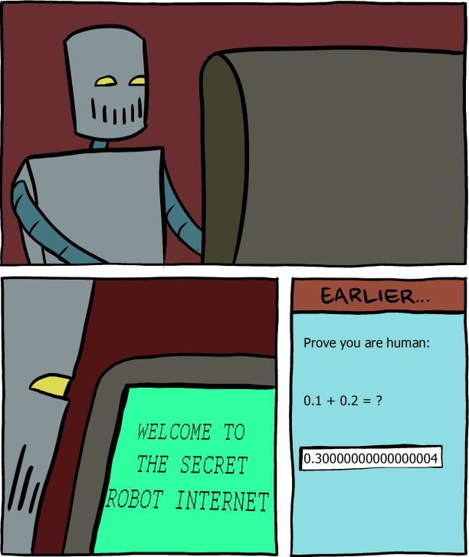
Now you can make float jokes too…
Saturday Morning Breakfast Comics
www.smbc-comics.com/comic/2013-06-05
Side note: the robot is using IEEE 754 double-precision.
(double) 0.3:
0.29999999999999999
(double) 0.1 + (double) 0.2:
0.30000000000000004

Slide 11
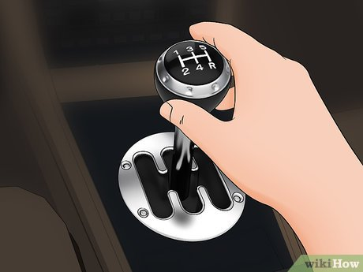
(change of gears)

Slide 12
The RISC-V Instruction Set Architecture
Floating Point Discussion
The RISC-V Instruction Set Architecture
Elements of Architecture: Registers
Add/Sub Instructions
Immediates

Slide 13


Great Idea #1: Abstraction (Levels of Representation/Interpretation)
High Level Language Program (e.g., C)
temp = v[k];
v[k] = v[k+1];
v[k+1] = temp;
Compiler
Anything can be represented as a number, i.e., data or instructions
Assembly Language Program (e.g., RISC-V)
lw x3, 0(x10)
lw x4, 4(x10)
sw x4, 0(x10)
sw x3, 4(x10)
Assembler
1000 1101 1110 0010 0000 0000 0000 0000
1000 1110 0001 0000 0000 0000 0000 0100
1010 1110 0001 0010 0000 0000 0000 0000
1010 1101 1110 0010 0000 0000 0000 0100
Machine Language Program (RISC-V)
Hardware Architecture Description (e.g., block diagrams)
+4
Reg
[]
pc
pc+4
1
wb
DataD
Reg
[rs1]
1
ALU
alu
2
alu
0
pc
IMEM
inst
[11:7]
AddrD
Reg
[rs2]
0
Addr
DMEM
1
wb
pc+4
inst
[19:15]
AddrA
DataA
Branch
0
DataW
DataR
mem
0
Architecture Implementation
inst
[24:20]
AddrB
DataB
Comp.
1
Logic Circuit Description (Circuit Schematic Diagrams)
inst
[31:7]
Imm
.
imm
[31:0]
Gen

Slide 14
Assembly Language
Basic job of a CPU: execute lots of instructions.
Instructions are the primitive operations that the CPU may execute.
Like a sentence: operations (verbs) applied to operands (objects), processed in sequence …
Different CPUs implement different sets of instructions. The set of instructions a particular CPU implements is an Instruction Set Architecture (ISA).
Examples: ARM (cell phones), Intel x86 (i9, i7, i5, i3), IBM/Motorola PowerPC (old Macs), MIPS, RISC-V, ...

Slide 15

Book: Programming From the Ground Up
“A new book was just released which is based on a new concept – teaching computer science through assembly language (Linux x86 assembly language, to be exact). This book teaches how the machine itself operates, rather than just the language. I've found that the key difference between mediocre and excellent programmers is whether or not they know assembly language. Those that do tend to understand computers themselves at a much deeper level. Although [almost!] unheard of today, this concept isn't really all that new -- there used to not be much choice in years past. Apple computers came with only BASIC and assembly language, and there were books available on assembly language for kids. This is why the old-timers are often viewed as 'wizards': they had to know assembly language programming.” -- slashdot.org comment, 2004-02-05

Slide 16
Instruction Set Architectures
Early trend was to add more and more instructions to new CPUs to do elaborate operations.
VAX architecture had an instruction to multiply polynomials!
Reduced Instruction Set Computer (RISC) philosophy:
Cocke IBM, Patterson, Hennessy, 1980s.
Keep the instruction set small and simple, makes it easier to build fast hardware.
Let software do complicated operations by composing simpler ones.
This went against the conventional wisdom of the time. (he who laughs last, laughs best)
Notes:
https://en.wikipedia.org/wiki/VAX
John Cocke IBM 801 1980 - This was not well publicized as it was an internal company project.
John Hennessey Stanford MIPS 1981
David Patterson Berkeley RISC 1980

Slide 17

Patterson and Hennessy win Turing!
https://engineering.berkeley.edu/news/2018/06/patterson-wins-turing-award/
Notes:
2017: For pioneering a systematic, quantitative approach to the design and evaluation of computer architectures with enduring impact on the microprocessor industry.
Patterson first met John Hennessy at a meeting for DARPA funded research VLSI projects in 1980 or 1981 where each was presenting their ideas. RISC-2 emerged simultaneously with Hennessy’s MIPS (Microprocessor without Interlocked Pipeline Stages) prototype at Stanford in 1983. Arguments between RISC vs. MIPS designs were soon dwarfed by their common thesis against CISC (Complex Instruction Set Computers), used by the entire industrial computer design community.
https://amturing.acm.org/award_winners/patterson_2316693.cfm
https://amturing.acm.org/award_winners/hennessy_1426931.cfm

Slide 18
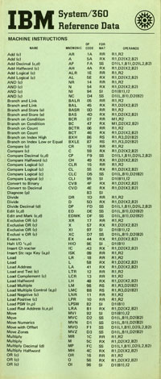
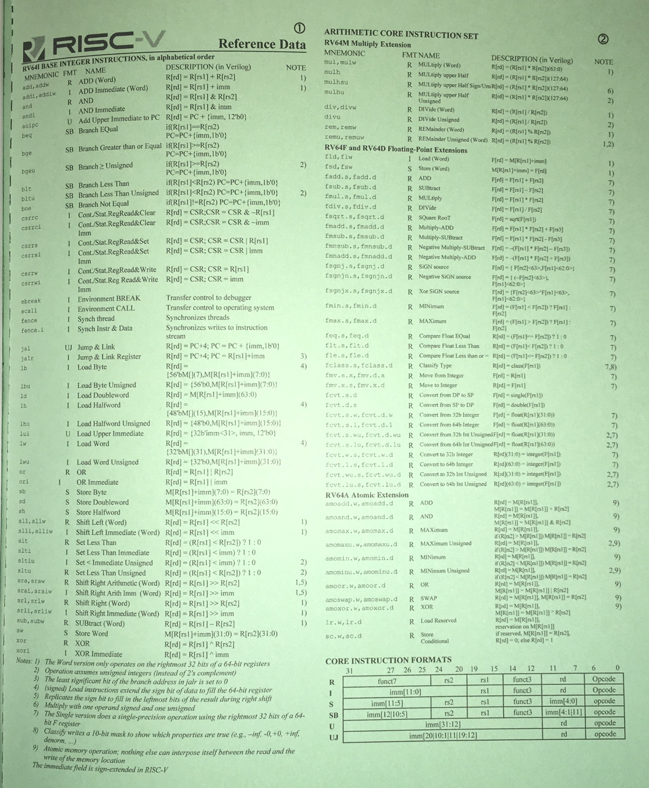
RISC-V Architecture
IBM 360 Green Card
New open-source, license-free ISA spec
Supported by growing shared software ecosystem
Appropriate for all levels of computing system, from microcontrollers to supercomputers
32-bit, 64-bit, and 128-bit variants (class/textbook uses 32-bit)
Why RISC-V instead of Intel x86-64?
RISC-V is simple and elegant. We don’t need to get bogged down in gritty details.
RISC-V has exponential adoption, from microcontrollers to CPUs to warehouse-scale computers.
https://cs61c.org/ → Resources
RISC-V Green Card

Slide 19
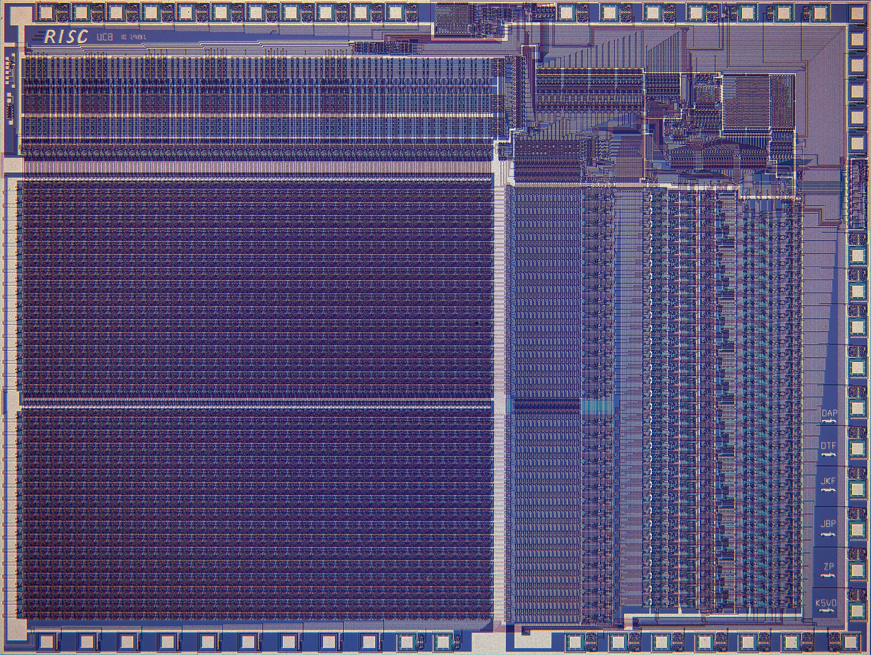
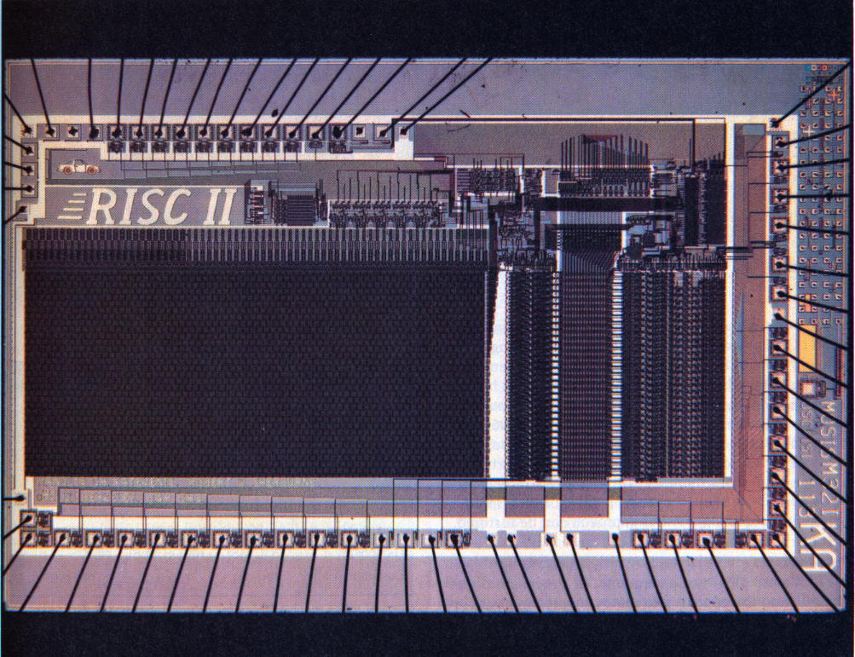

RISC-V Origins
Started in Summer 2010 to support open research and teaching at UC Berkeley
Lineage can be traced to RISC-I/II projects (1980s)
As the project matured, it migrated to RISC-V foundation (www.risc-v.org)
Many commercial and research projects based on RISC-V.
Open-source and proprietary
Widely used in education
Read more:
https://riscv.org/risc-v-history/
https://riscv.org/risc-v-genealogy/
RISC-I
RISC-II

Slide 20
Elements of Architecture: Registers
Floating Point Discussion
The RISC-V Instruction Set Architecture
Elements of Architecture: Registers
Add/Sub Instructions
Immediates

Slide 21
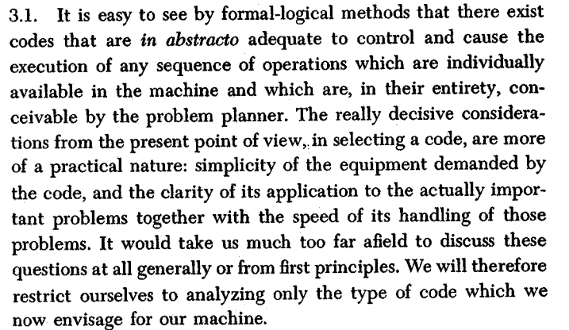
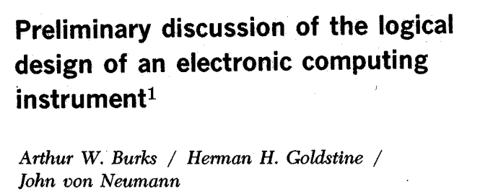
Instruction Set
“instruction sets”
Instruction set for a particular architecture (e.g. RISC-V) is represented by the assembly language.
Each line of assembly code represents one instruction for the computer.
add x1, x2, x3
operation name
registers

Slide 22
Higher-Level Language vs. Assembly Language (1/2)
C, Java
RISC-V
In C (and most high-level languages), variables declared first and given a type.
int fahr, celsius; char a, b, c, d, e;
Each variable can ONLY represent a value of the type it was declared as (cannot mix/match int/char variables).
In high-level languages, variable types determine operation.
int *p = …; p = p + 2; int x = 42; x = 3 * x;
Assembly operands are registers.
Registers are limited number of special locations, built directly into the hardware.
RISC-V: Operations can only be performed on register operands.
In assembly language, the registers have no type.
Register contents are just bits.
Operation determines “type,” i.e., how register contents are treated.
E.g., as value, memory address, etc.

Slide 23
Registers are Inside the Processor
Benefit: Since registers are directly in hardware, they’re very fast (faster than 0.25ns).
Speed of light: 3x10⁸m/s = 0.3m/ns = 30cm/ns = 10cm/0.3ns!!!
0.3ns is the clock period of a 3.33GHz computer
Processor-Memory Interface
I/O-Memory Interfaces
Notes:
Apple M1 Chip is 3.1 GHz max clock rate
7/10 nm transistor density

Slide 24
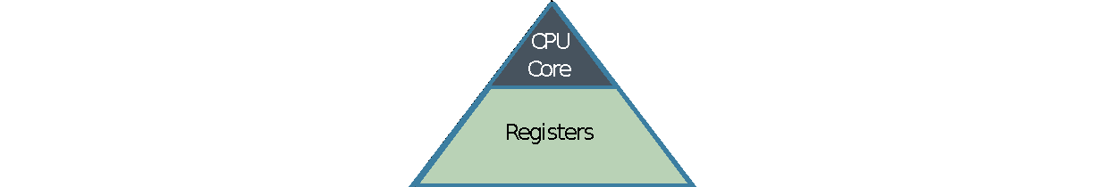
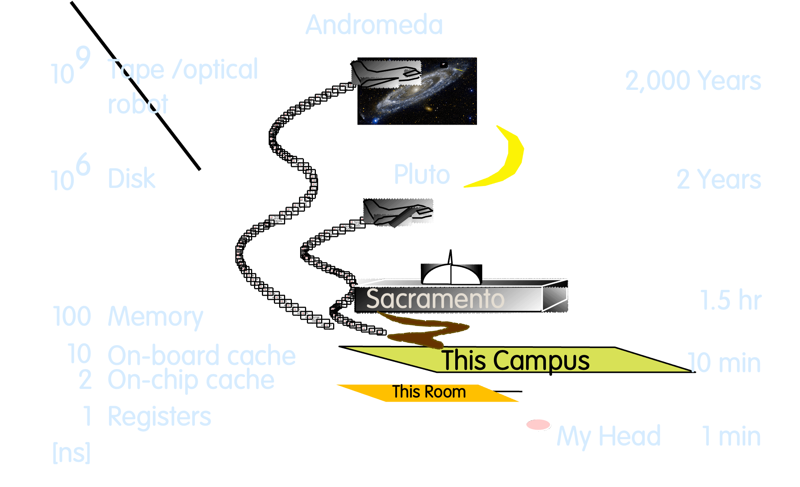
Great Idea #3: Principle of Locality / Memory Hierarchy
Processor chip
Extremely fast
Extremely expensive Tiny capacity
Storage Latency Analogy

Slide 25
32 Registers in RISC-V
Drawback: Each ISA a predetermined number of registers.
Why? Registers are built into hardware.
Solution: RISC-V code must be very carefully put together to efficiently use registers.
Nowadays: compiler maps C variables to RISC-V registers across declarations, function calls, etc.
32 registers in RISC-V.
Why 32? Smaller is faster, but too small is bad.
Goldilocks principle (“This porridge is too hot; This porridge is too cold; this porridge is just right”)
Each RISC-V register is 32 bits wide (in RV32 variant).
Groups of 32 bits called a word in RV32.

Slide 26
Register Names and Numbers
Registers are numbered from 0 to 31.
Referred to by number x0 – x31.
x0 is special, always holds value zero.
So only 31 registers able to hold variable values.
Each register can be referred to by number or name.
We’ll explain names next week.
Ok, enough already…gimme my RV32!!!

Slide 27
Add/Sub Instructions
Floating Point Discussion
The RISC-V Instruction Set Architecture
Elements of Architecture: Registers
Add/Sub Instructions
Immediates

Slide 28
Higher-Level Language vs. Assembly Language (2/2)
C, Java
RISC-V
Each line can contain multiple operations.
a = b * 2 - (arr[2] + *p);
Common operations are:
=, +, –, *, /
Here, * includes both multiply and dereference
Each statement is an instruction.
An instruction executes exactly one short list of simple commands.
Each line of assembly code contains at most 1 instruction.
add x1, x2, x3
sub x1, x1, x4
The compiler translates from higher-level language down to assembly… …so RISC-V instructions are often closely related to common C/Java operations.

Slide 29
RISC-V Arithmetic Instruction Syntax
opname rd, rs1, rs2
operation, by name
”destination”
operand getting result
”source1”
1st operand for operation
”source2”
2nd operand for operation
Syntax is rigid:
1 operator, 3 operands.
Why? Keep hardware simple via regularity. (more in a few weeks)

Slide 30
RISC-V Addition and Subtraction
opname rd, rs1, rs2
operation, by name
”destination”
operand getting result
”source1”
1st operand for operation
”source2”
2nd operand for operation
Addition
Subtraction
RISC-V
C
add x1,x2,x3
a = b + c;
RISC-V
C
sub x4,x5,x6
d = e – f;
(remember!
order of operands matter in sub)

Slide 31
RISC-V Arithmetic, Example 1
How could we translate this C statement?
a = b + c + d - e;
Assume the above mapping for C variables ↔︎ RISC-V registers.
Solution: Break into multiple instructions!
add x10, x1, x2 # a_temp = b + c
add x10, x10, x3 # a_temp = a_temp + d
sub x10, x10, x4 # a = a_temp - e
x10 x1 x2 x3 x4
A single line of C may break up into several lines of RISC-V.
In-line comments prefixed by #, work like C99’s //.
Unlike C, no multi-line comment (/* */) support.

Slide 32
RISC-V Arithmetic, Example 2
How do we do this?
f = (g + h) - (i + j);
Assume the above mapping for C variables ↔︎ RISC-V registers.
Solution: Use intermediate temporary registers!
add x5, x20, x21 # a_temp = g + h
add x6, x22, x23 # b_temp = i + j
sub x19, x5, x6 # f = (g + h)- (i + j)
Note: A good compiler may actually do the following. Why?
f = g + h - i - j;
x19 x20 x21 x22 x23 x5 x6
Can use zero temp registers!

Slide 33
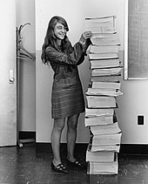
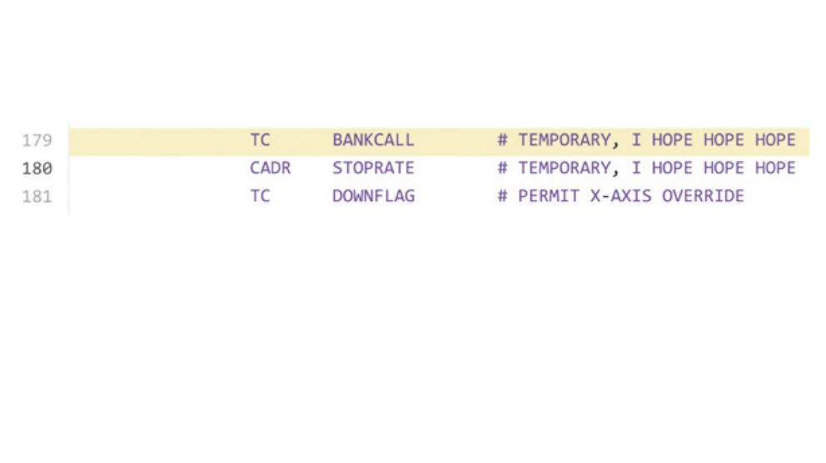
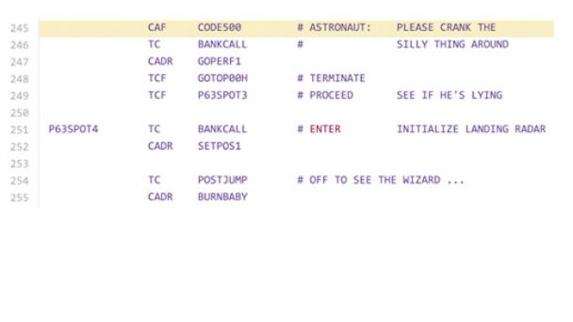
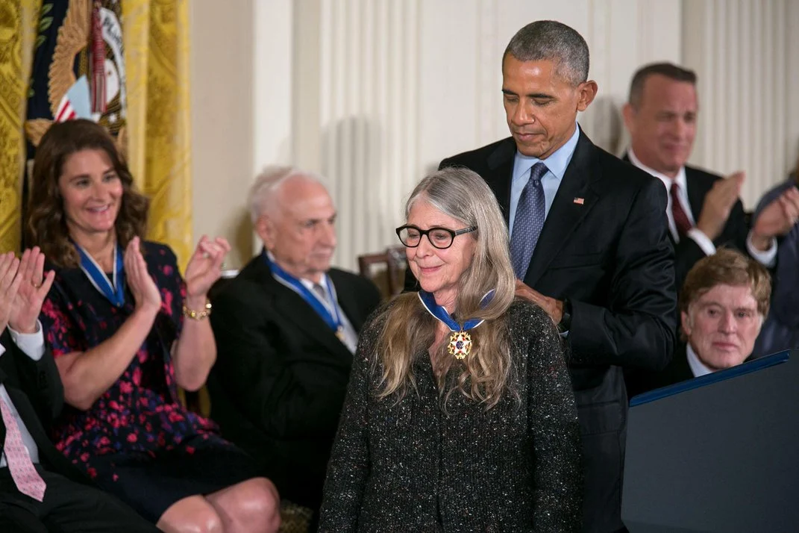
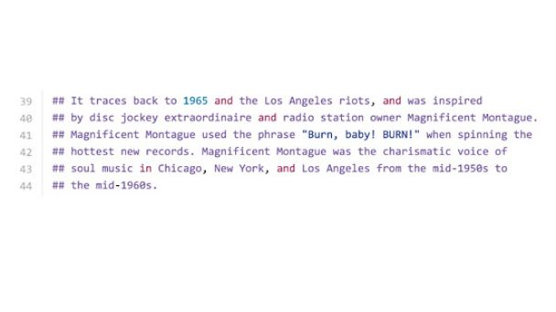
Aside: Apollo Guidance Computer
Margaret Hamilton Director of Software Engineering Division of MIT Instrumentation Laboratory
Built Apollo Guidance Computer Command Module (navigation, lunar landing)
72KB of memory on board Eagle (Apollo 11, 1969)
Margaret Hamilton and Apollo code
Wikimedia Commons
Presidential Medal of Freedom (2016)
ignition file
https://abcnews.go.com/Technology/apollo-11s-source-code-tons-easter-eggs-including/story?id=40515222
Notes:
https://www.smithsonianmag.com/smithsonian-institution/margaret-hamilton-led-nasa-software-team-landed-astronauts-moon-180971575/
https://www.ibiblio.org/apollo/assembly_language_manual.html
Obama is 6’2”

Slide 34
Immediates
Floating Point Discussion
The RISC-V Instruction Set Architecture
Elements of Architecture: Registers
Add/Sub Instructions
Immediates

Slide 35
Immediates
Immediates are numerical constants.
They appear often in code; hence, they have separate instructions.
Add Immediate instruction:
RISC-V
C
addi x3,x4,10
f = g + 10;
Syntax similar to add instruction. But the last operand must be a number, not a register.

Slide 36
Immediates
Immediates are numerical constants.
They appear often in code; hence, they have separate instructions.
Add Immediate instruction:
There is no Subtract Immediate instruction in RISC-V. Why?
While there are add and sub instructions, to subtract an immediate, just use addi:
RISC-V
C
addi x3,x4,10
f = g + 10;
Syntax similar to add instruction. But the last operand must be a number, not a register.
RISC-V
C
addi x3,x4,-10
f = g - 10;
RISC Philosophy: Reduce the possible types of operations to an absolute minimum.
If an operation can be decomposed into a simpler operation, don’t include it in the ISA.
Notes:
RISC: reduced instruction set computer

Slide 37
Register Zero
One particular immediate, the number zero (0), appears very often in code.
RISC-V hardwires the register zero (x0) to value 0:
Defined in hardware, so an instruction add x0,x3,x4 will not do anything!
RISC-V
C
add x3,x4,x0
f = g;
RISC-V
C
addi x3,x0,0xff
f = 0xff;

Slide 38
Concept Check: True or False?
Types are associated with declaration in C (normally), but are associated with instructions (operators) in RISC-V.
Since there are only 32 registers, we can’t write RISC-V for C expressions that contain > 32 variables.
If p (stored in x9) were a pointer to an array of ints, then p++; would be addi x9 x9 1
123
FFF
FFT
FTF
FTT
TFF
TFT
TTF
TTT

Slide 39
Concept Check: True or False?
Types are associated with declaration in C (normally), but are associated with instructions (operators) in RISC-V.
Since there are only 32 registers, we can’t write RISC-V for C expressions that contain > 32 variables.
If p (stored in x9) were a pointer to an array of ints, then p++; would be addi x9 x9 1
123
FFF
FFT
FTF
FTT
TFF
TFT
TTF
TTT
1. True, we saw that on an earlier slide.
2. False. we saw how to break up longer equations to smaller ones already.
3. False. Don’t forget that ints are (usually) 4 bytes wide, so instruction would be addi x9, x9, 4.
Notes:
1. True, we saw that on an early slide.
2. False. we saw how to break up longer equations to smaller ones already.
3. False. Don’t forget that ints are (usually) 4 bytes wide.

